Slide 1
Introduction to DIP
Lecture 2

Slide 2
Image – digital image
An image is a two-dimensional function f(x,y), where x and y are the spatial (plane) coordinates, and the amplitude of f at any pair of coordinates (x,y) is called the intensity of the image at that level.
If x,y and the amplitude values of f are finite and discrete quantities, we call the image a digital image. A digital image is composed of a finite number of elements called pixels, each of which has a particular location and value.

Slide 3
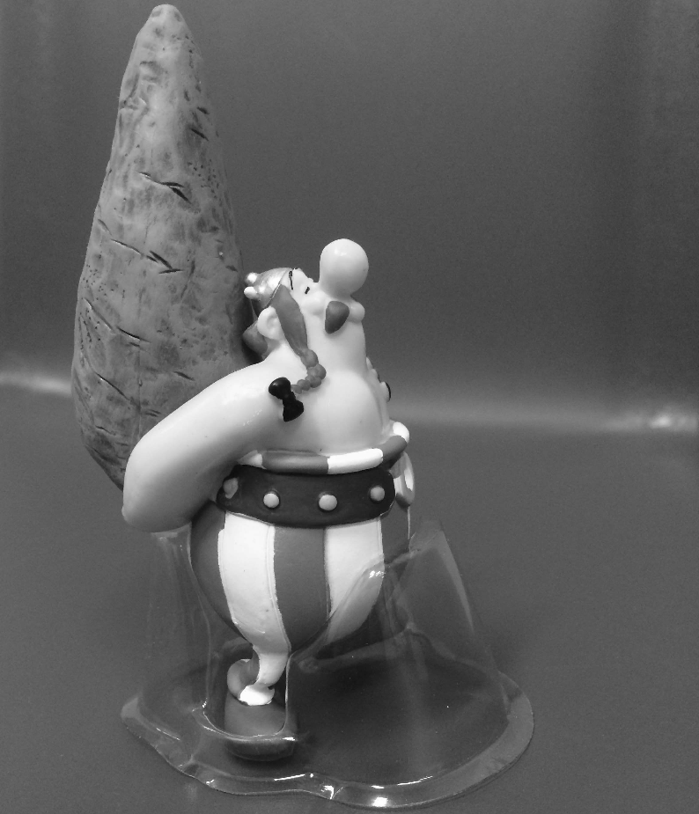
Consider the following image (2724x2336 pixels) to be 2D function or a matrix with rows and columns
Pixel intensity value
f(1,1) = 103
Pixel location
In 8-bit representation
Pixel intensity values change between 0 (Black) and 255 (White)
rows
columns
83 82 82 82 82 82
82 82 82 81 81 81
82 82 81 81 80 80
82 82 81 80 80 79
80 79 78 77 77 77
80 79 78 78 77 77
f(2724,2336) = 88

Slide 4
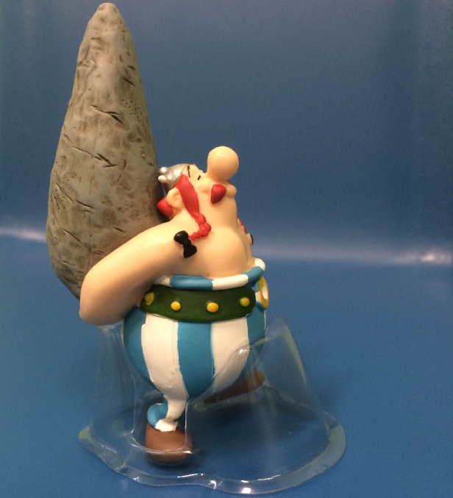

Remember digitization implies that a digital image is an approximation of a real scene
One pixel

Slide 5


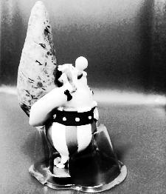


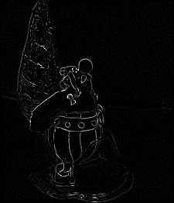

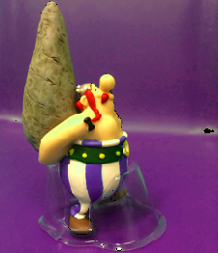
Digital Image Processing

Slide 6
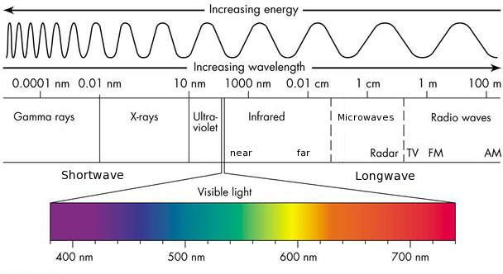
Sources of Digital Images
The principal source for the images is the electromagnetic (EM) energy spectrum.

Slide 8
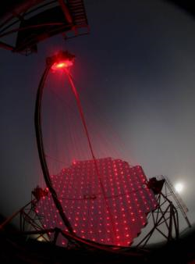
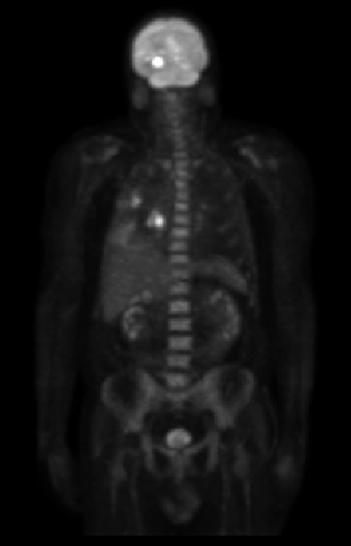
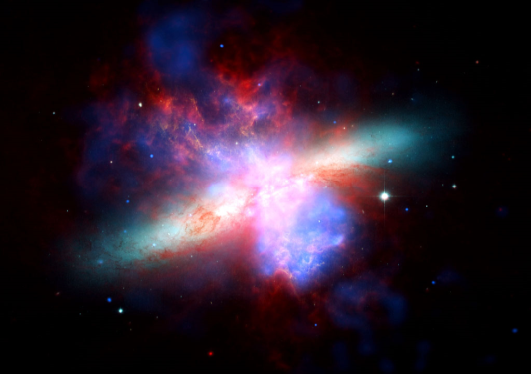
Gamma rays
Gamma-Ray imaging of
A starburst galaxy about 12 million light-years away
Gamma-Ray Imaging
Cherenkov Telescope
Gamma-Ray Imaging
İn nuclear medicine

Slide 9
X- rays

Slide 10
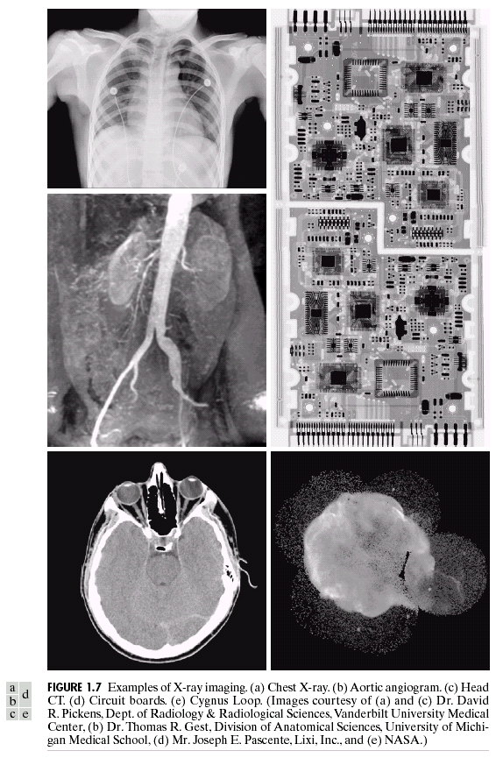
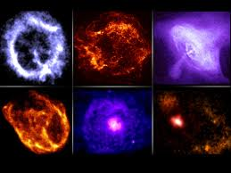
X- rays
X-ray images from the space
The Chandra X-Ray Observatory

Slide 11
Ultra-violet
© 2002 R. C. Gonzalez & R. E. Woods

Slide 12
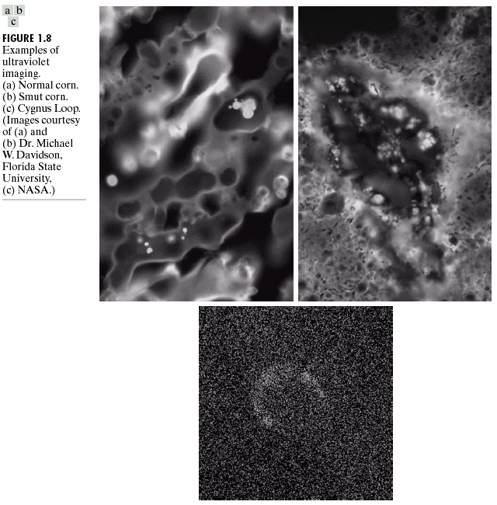
Ultra-violet
© 2002 R. C. Gonzalez & R. E. Woods

Slide 13
Visible light

Slide 14
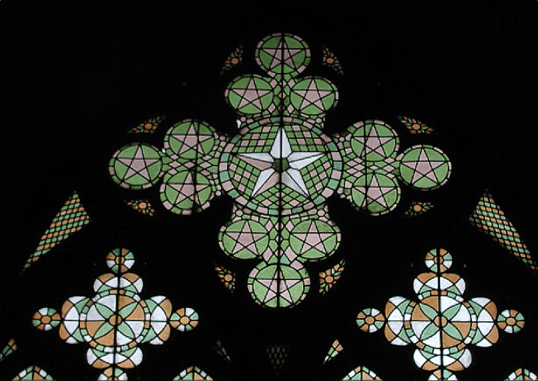




Visible light
R
G
B

Slide 15
Infrared
© 2002 R. C. Gonzalez & R. E. Woods

Slide 16
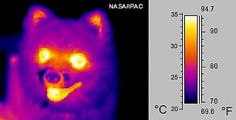
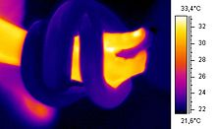
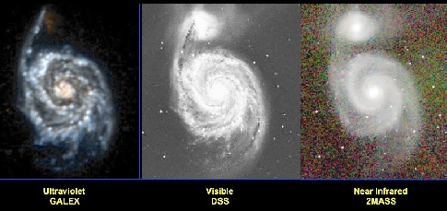
Infrared
infrared ("thermal") image Snake around the arm
Messier 51 in ultraviolet (GALEX), visible (DSS), and near infrared (2MASS). Courtesy of James Fanson.
© 2002 R. C. Gonzalez & R. E. Woods

Slide 17
Microwaves
© 2002 R. C. Gonzalez & R. E. Woods

Slide 18
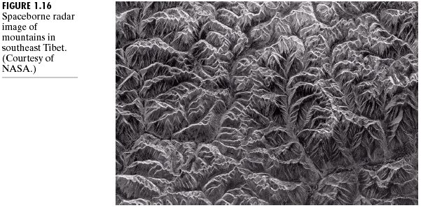
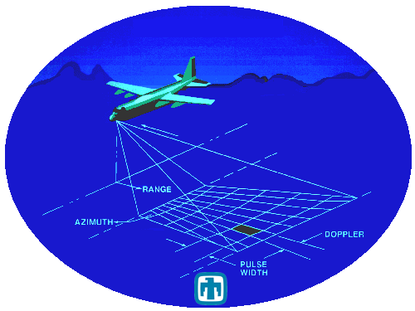
Microwaves
Synthetic Aperture Radar
System
© 2002 R. C. Gonzalez & R. E. Woods

Slide 19
Radio Waves
© 2002 R. C. Gonzalez & R. E. Woods

Slide 20
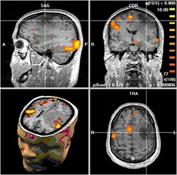
Radio Waves
MRI image slices from the brain
© 2002 R. C. Gonzalez & R. E. Woods

Slide 21
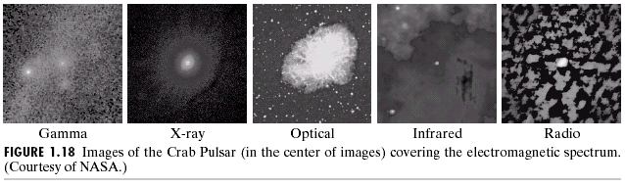
Digital Images based on the EM Spectrum
An example showing Imaging in all of the bands
Visible light
© 2002 R. C. Gonzalez & R. E. Woods

Slide 22
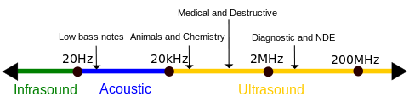
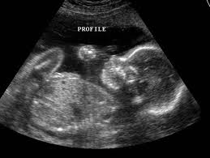
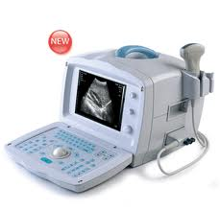
Ultrasound Imaging
Ultrasonic spectrum
Ultrasonic Baby image during pragnancy
Ultrasound image acquisition device
© 2002 R. C. Gonzalez & R. E. Woods

Slide 23
The continuum from image processing to computer vision can be broken up into low-, mid- and high-level processes
Low Level Process
Mid Level Process
High Level Process
Input: Image
Output: Image
Examples: Noise removal, image sharpening
Input: Image
Output: Attributes
Examples: Object recognition, segmentation
Input: Attributes
Output: Understanding
Examples: Scene understanding, autonomous navigation
Notes:
Give the analogy of the character recognition system.
Low Level: Cleaning up the image of some text
Mid level: Segmenting the text from the background and recognising individual characters
High level: Understanding what the text says

Slide 24
Digital Image Processing
Sampling and Quantization

Slide 25
key stages in digital image processing
Sampling : related to coordinates values
(Nyquist frequency)
Quantization : related to intensity values

Slide 26
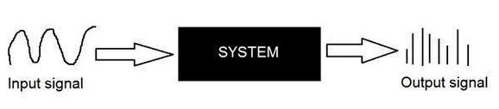
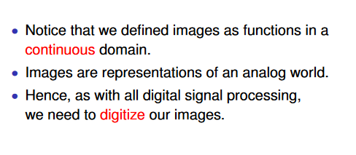
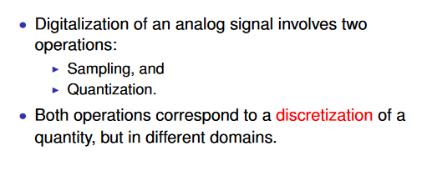
Basic Analog to Digital Signals

Slide 27
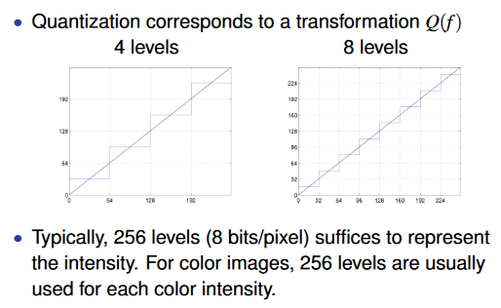

Slide 28
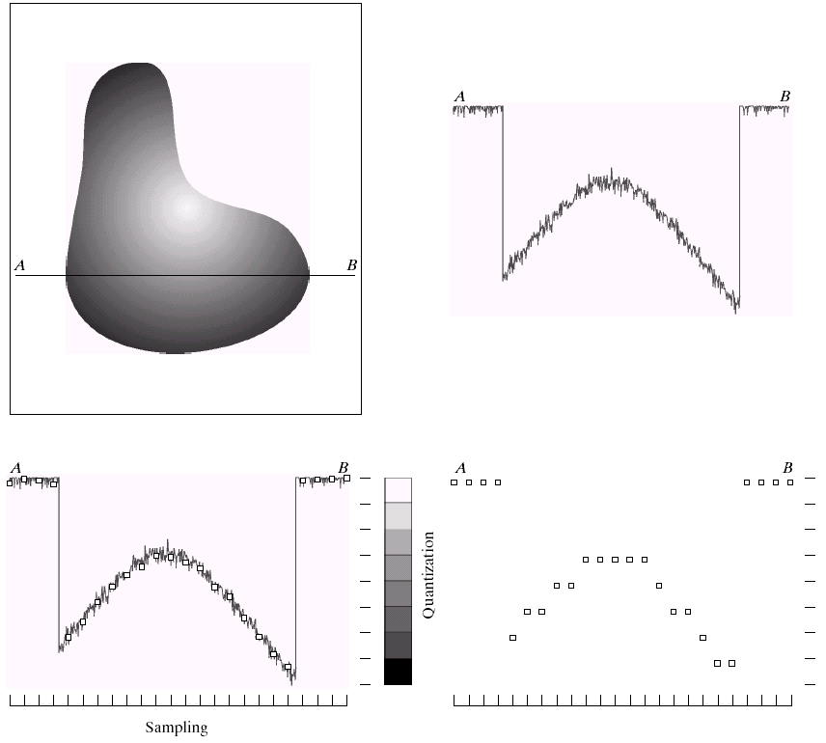
y (intensity values)
a | b
c | d
Generating a digital image. (a) Continuous image. (b) A scaling line from A to B in the continuous image, used to illustrate the concepts of sampling and quantization. (c) sampling and quantization. (d) Digital scan line.
© 2002 R. C. Gonzalez & R. E. Woods

Slide 29

a | b
(a) Continuous image projected onto a sensor array. (b) Result of image sampling and quantization.
© 2002 R. C. Gonzalez & R. E. Woods

Slide 30

0 | 0 | 0 | 75 | 75 | 75 | 128 | 128 | 128 | 128
0 | 75 | 75 | 75 | 128 | 128 | 128 | 255 | 255 | 255
75 | 75 | 75 | 200 | 200 | 200 | 255 | 255 | 255 | 200
128 | 128 | 128 | 200 | 200 | 255 | 255 | 200 | 200 | 200
128 | 128 | 128 | 255 | 255 | 200 | 200 | 200 | 75 | 75
175 | 175 | 175 | 225 | 225 | 225 | 75 | 75 | 75 | 100
175 | 175 | 100 | 100 | 100 | 225 | 225 | 75 | 75 | 100
75 | 75 | 75 | 35 | 35 | 35 | 0 | 0 | 0 | 35
35 | 35 | 35 | 0 | 0 | 0 | 35 | 35 | 35 | 75
75 | 75 | 75 | 100 | 100 | 100 | 200 | 200 | 200 | 200

Slide 31
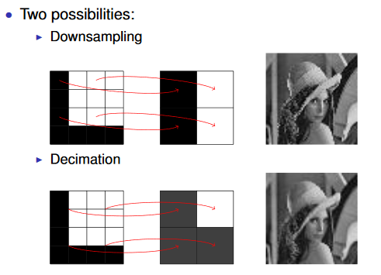

Slide 32
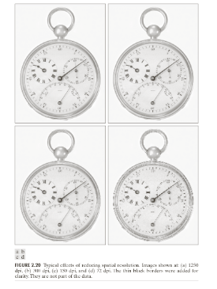

Slide 33

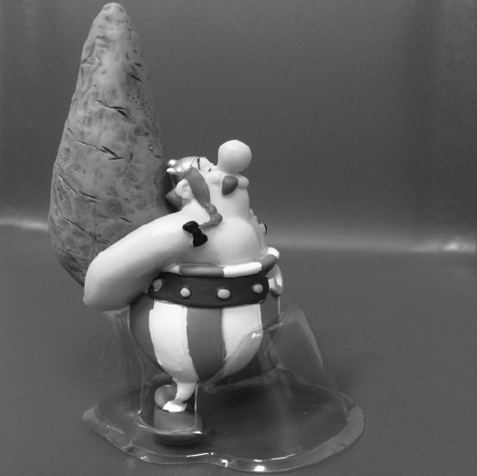

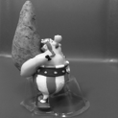
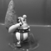
Sampling
32
64
128
256
512
1024

Slide 34
Sampling
1024
512
256
128
64
32

Slide 35
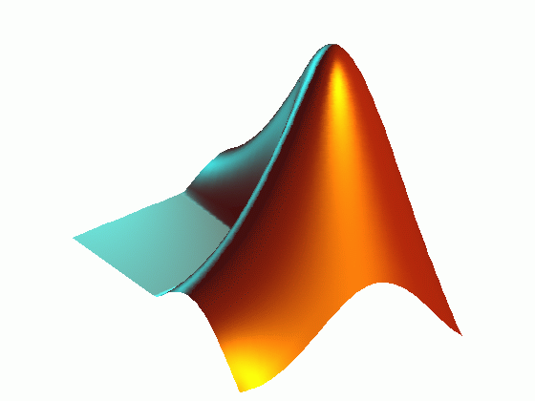
imread() – reading an image with different postfixes
imresize() – resizing an image to any given size
figure – opening a new graphical window
subplot(#of row, # of col, location) – showing different plots/images in one graphical window
imshow() – displaying an image

Slide 36
generating figures of slide 6
im=imread('obelix.jpg');
im=rgb2gray(imread('obelix.jpg'));
im1=imresize(im, [1024 1024]);
im2=imresize(im1, [1024 1024]/2);
im3=imresize(im1, [1024 1024]/4);
im4=imresize(im1, [1024 1024]/8);
im5=imresize(im1, [1024 1024]/16);
im6=imresize(im1, [1024 1024]/32);
figure;imshow(im1)
figure;imshow(im2)
figure;imshow(im3)
figure;imshow(im4)
figure;imshow(im5)

Slide 37
generating figure of slide 7
figure;
subplot(2,3,1);imshow(im1);subplot(2,3,2);imshow(im2)
subplot(2,3,3);imshow(im3);subplot(2,3,4);imshow(im4)
subplot(2,3,5);imshow(im5);subplot(2,3,6);imshow(im6)

Slide 38
Quantization
8-bit
7-bit
6-bit
5-bit
4-bit
3-bit
2-bit
1-bit

Slide 39
generating figure of slide 11
im=imread('obelix.jpg');
im=rgb2gray(imread('obelix.jpg'));
im1=imresize(im, [1024 1024]);
im2= gray2ind(im1,2^7);
im3= gray2ind(im1,2^6);
im4= gray2ind(im1,2^5);
im5= gray2ind(im1,2^4);
im6= gray2ind(im1,2^3);
im7= gray2ind(im1,2^2);
im8= gray2ind(im1,2^1);

Slide 40
figure;
subplot(2,4,1);imshow(im1,[]);subplot(2,4,2);imshow(im2,[])
subplot(2,4,3);imshow(im3,[]);subplot(2,4,4);imshow(im4,[])
subplot(2,4,5);imshow(im5,[]);subplot(2,4,6);imshow(im6,[])
subplot(2,4,7);imshow(im7,[]);subplot(2,4,8);imshow(im8,[])

Slide 41

Image Resolution
Pixel Resolution: is often considered equivalent to pixel count in digital imaging.
In pixel resolution, the term resolution refers to the total number of count of pixels in an digital image. For example. If an image has M rows and N columns, then its resolution can be defined as M X N.
pixel resolution of an image as 1200 X 500.
How to calculate Megapixels?
We can calculate mega pixels of a camera using pixel resolution.
Column pixels (width ) X row pixels ( height ) / 1 Million.
Lets say we have an image of dimension: 2500 X 3192.
Its pixel resolution = 2500 * 3192 = 7982350 bytes.
Dividing it by 1 million = 7.9 = 8 mega pixel (approximately).

Slide 42
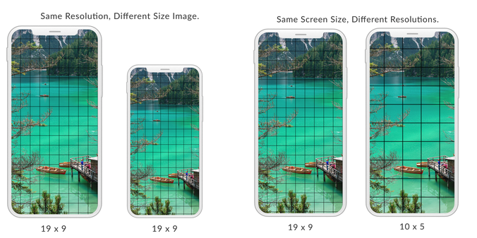

Slide 43
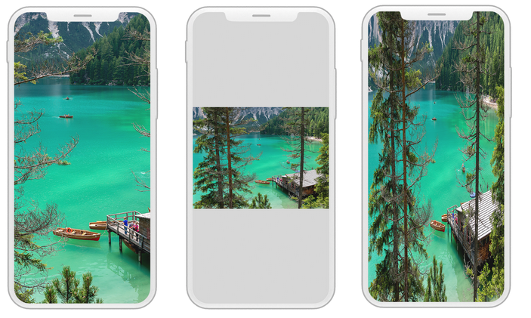
Aspect Ratio
Aspect ratio is the ratio between width of an image and the height of an image. It is commonly explained as two numbers separated by a colon (8:9).

Slide 44
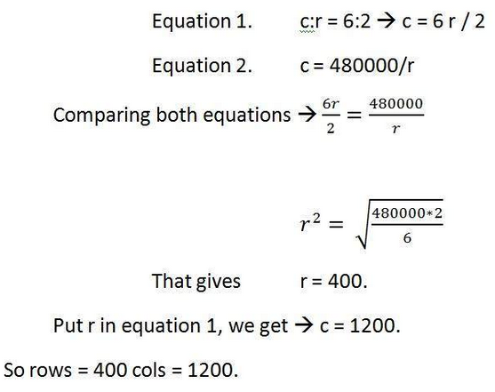
Problem to be solved
Given info:
Aspect ratio: c:r = 6:2
Pixel resolution: c * r = 480000
Bits per pixel: grayscale image = 8bpp
Find the rows and cols? ????????
Now Calculate the size of the image ?????
Size = rows * cols * bpp
Size of image in bits = 400 * 1200 * 8
= 3840000 bits
Size of image in bytes = 480000 bytes

Slide 45
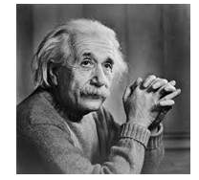
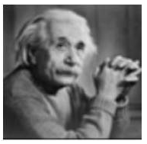
Spatial resolution
Spatial resolution states that the clarity of an image cannot be determined by the pixel resolution. The number of pixels in an image does not matter.
Compare ?????
Both have same size
They are measured on
1. Dots per inch (Monitors)
2. Lines per inch (Printers )
3. Pixels per inch (Mobile phones. Smart gadgets)

Slide 46
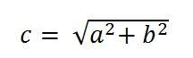
Spatial Resolution Pixel Per Inch (PPI) Calculation
PPI = c / diagonal size in inches
Where a and b are the height and width resolutions in pixel and c is the diagonal resolution in pixels.
If Mobile Phone of 5.0 inches then
PPI = 2202.90717/5.0
PPI = 440.58
PPI = 441 (approx)
That means that the pixel density of Mobile Phone is 441 PPI.

Slide 47
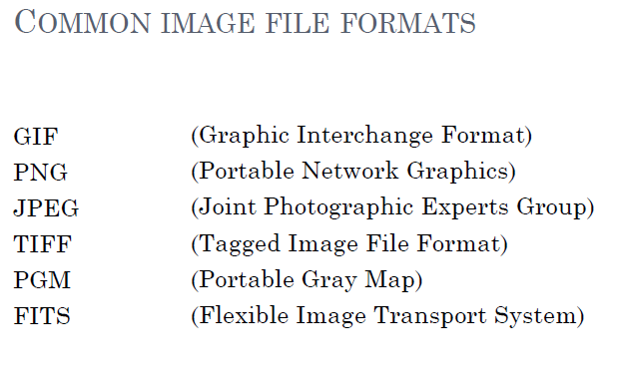

Slide 48
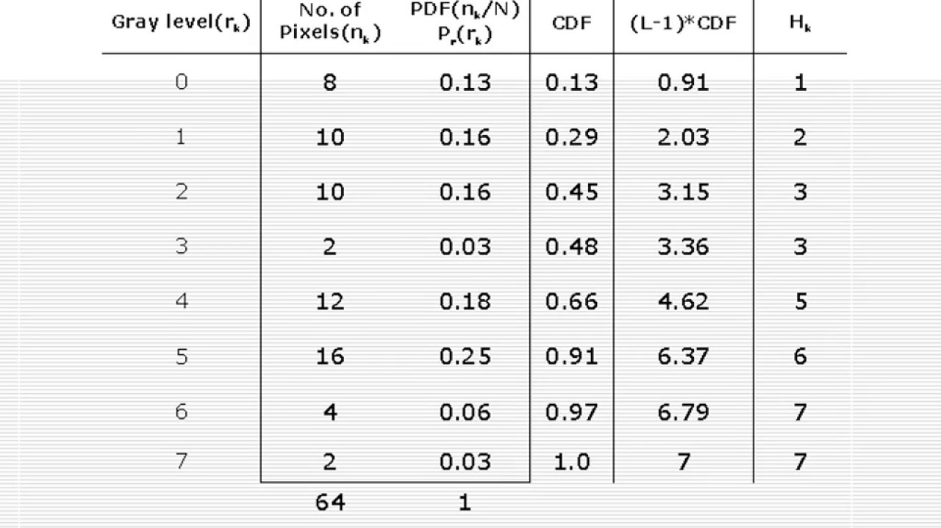
Image enhancement: Histogram Equalization Example

Slide 49
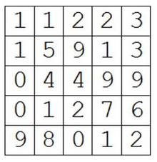
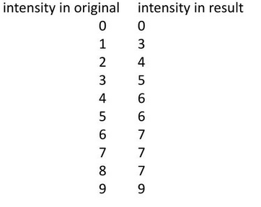
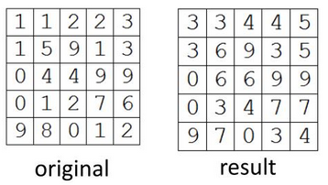
Example 2

